Slide 1
DOCKER

Slide 2
Agenda
1. What is docker?
Before docker
Introduction of docker
Why docker?
Architecture of docker
Installation steps of docker
Docker hub
Docker Images
Docker Containers
Docker Commands
Working with Container

Slide 3
DOCKER
Docker is a container management service.
The keywords of Docker are develop, ship and run anywhere.
The whole idea of Docker is for developers to easily develop applications, ship them into containers which can then be deployed anywhere.

Slide 4
Before docker
2000: FreeBSD Jails
In 2000 small shared-environment hosting provider came up with FreeBSD jails. FreeBSD Jails allows administrators to partition a FreeBSDcomputer system into several independent, smaller systems – called “jails” – with the ability to assign an IP address for each system and configuration.
2001: Linux VServer
Like FreeBSD Jails, Linux VServer is a jail mechanism that can partition resources (file systems, network addresses, memory) on a computer system.
2008: LXC
LXC (LinuX Containers) was the first, most complete implementation of Linux container manager. It was implemented in 2008 using cgroups and Linux namespaces, and it works on a single Linux kernel without requiring any patches.
https://blog.aquasec.com/a-brief-history-of-containers-from-1970s-chroot-to-docker-2016

Slide 5
Introduction of Docker
Docker was first released in 2013 and is developed by Docker, Inc.
Features of Docker:
Docker has the ability to reduce the size of development by providing a smaller footprint of the operating system via containers.
With containers, it becomes easier for teams across different units, such as development, QA and Operations to work seamlessly across applications.
You can deploy Docker containers anywhere, on any physical and virtual machines and even on the cloud.
Since Docker containers are pretty lightweight, they are very easily scalable

Slide 6
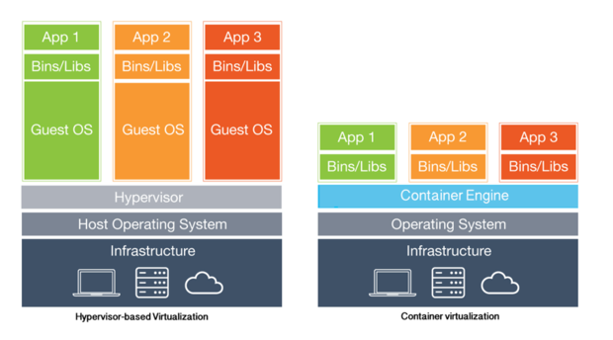
Why docker ?
The server is the physical server that is used to host multiple virtual machines.
The Host OS is the base machine such as Linux or Windows.
The Hypervisor is either VMWare or Windows Hyper V that is used to host virtual machines.
You would then install multiple operating systems as virtual machines on top of the existing hypervisor as Guest OS.
You would then host your applications on top of each Guest OS.

Slide 7
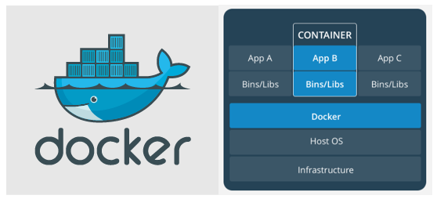
Architecture of docker
The server is the physical server that is used to host multiple virtual machines.
The Host OS is the base machine such as Linux or Windows.
Now comes the new generation which is the Docker
This is used to run the operating system which earlier used to be virtual machines as Docker containers.
All of the Apps now run as Docker containers.
The clear advantage in this architecture is that you don’t need to have extra hardware for Guest OS. Everything works as Docker containers.

Slide 8
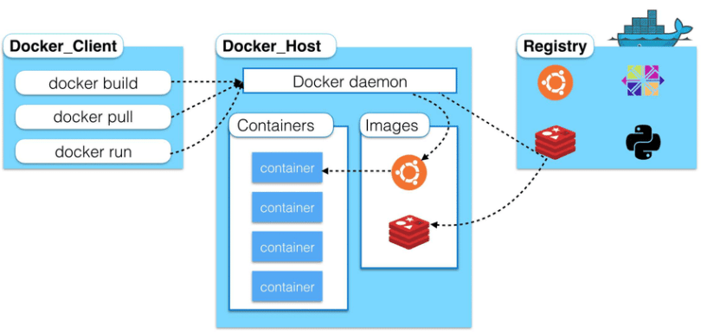
The basic architecture of Docker consists of 3 major parts: 1. Docker Host 2. Docker Client 3. Registry
Docker uses a client-server architecture. The Docker client talks to the Docker daemon, which does the building, running, and distributing your Docker containers. The Docker client and daemon can run on the same system, or you can connect a Docker client to a remote Docker daemon. The Docker client and daemon communicate using a REST API, over UNIX sockets or a network interface.

Slide 9
Docker Host:
Docker Host runs the docker daemon.
Docker Daemon listens for Docker requests.
Docker requests could be ‘docker run’, ‘docker build’, anything.
It manages docker objects such as images, containers, networks, and volumes.

Slide 10
Docker Client:
Docker Client is used to trigger Docker commands.
When we send any command (docker build, docker run, etc) the docker client ends these commands to Docker daemon which further will deal with them.
The Docker client can communicate with more than one daemon.

Slide 11
Docker Registries:
The Registry is a stateless, highly scalable server-side application that stores and lets you distribute Docker images.
You can create your own image or you can use public registries namely, Docker Hub and Docker Cloud.
Docker is configured to look for images on Docker Hub by default.
when we run the command docker pull or docker run, the required images are pulled from your configured registry. When you use the docker push command, your image is pushed to your configured registry.

Slide 12
Installation of Docker
In Ubuntu:
First, in order to ensure the downloads are valid, add the GPG key for the official Docker repository to your system
curl -fsSL https://download.docker.com/linux/ubuntu/gpg | sudo apt-key add –
2. Add the Docker repository to APT sources:
sudo add-apt-repository "deb [arch=amd64] https://download.docker.com/linux/ubuntu $(lsb_release -cs) stable“
3. Next, update the package database with the Docker packages from the newly added repo
sudo apt-get update
4. Make sure you are about to install from the Docker repo instead of the default Ubuntu 16.04 repo
apt-cache policy docker-ce
5.
Finally, install Docker
sudo apt-get install -y docker-ce

Slide 13
In Redhat:
update the package database.
sudo yum check-update
2.
Now run this command. It will add the official Docker repository, download the latest version of Docker, and install it.
curl -fsSL https://get.docker.com/ | sh
3. After installation has completed, start the Docker daemon.
sudo systemctl start docker
4. Verify that it's running.
sudo systemctl status docker
https://www.digitalocean.com/community/tutorials/how-to-install-and-use-docker-on-ubuntu-16-04

Slide 14
Docker hub
Docker Hub is a registry service on the cloud that allows you to download Docker images that are built by other communities.
You can also upload your own Docker built images to Docker hub.
https://hub.docker.com/
Docker Hub provides the following major features:
Image Repositories: Find and pull images from community and official libraries, and manage, push to, and pull from private image libraries to which you have access.
Automated Builds: Automatically create new images when you make changes to a source code repository.
Webhooks: A feature of Automated Builds, Webhooks let you trigger actions after a successful push to a repository.
Organizations: Create work groups to manage access to image repositories.
GitHub and Bitbucket Integration: Add the Hub and your Docker Images to your current workflows.

Slide 15
Automated Builds:
You can build your images automatically from a build context stored in a repository.
A build context is a Dockerfile and any files at a specific location.
For an automated build, the build context is a repository containing a Dockerfile.
Automated Builds have several advantages:
Images built in this way are built exactly as specified.
Your repository is kept up-to-date with code changes automatically.
The Dockerfile is available to anyone with access to your Docker Hub repository.

Slide 16
Link to a hosted repository service:
Log into Docker Hub.
Navigate to Profile > Settings > Linked Accounts & Services.
Click the service you want to link.
The system prompts you to choose between Public and Private and Limited Access. The Public and Private connection type is required if you want to use the Automated Builds.
Press Select under Public and Private connection type.
The system prompts you to enter your service credentials (Bitbucket or GitHub) to login.
After you grant access to your code repository, the system returns you to Docker Hub and the link is complete.

Slide 17
Create an automated build:
Select Create > Create Automated Build (from the drop down, upper right) on Docker Hub.
The system prompts you with a list of User/Organizations and code repositories.
Select from the User/Organizations.
Optionally, type to filter the repository list.
Pick the project to build.
The system displays the Create Automated Build dialog.
Customize the automated build by pressing the Click here to customize this behavior link.
Specify which code branches or tags to build from.
2. Click Create.

Slide 18
Docker Images:
In Docker, everything is based on Images.
Images are a read-only binary template used to build containers.
An image is a combination of a file system and parameters.
A Docker image is made up of multiple layers.
A user composes each Docker image to include system libraries, tools, and other files and dependencies for the executable code.
An image is essentially built from the instructions for a complete and executable version of an application, which relies on the host OS kernel.

Slide 19
Docker Containers
Containers are instances of Docker images that can be run using the Docker run command.
Docker Container is a standardized unit which can be created to deploy a particular application or environment.
It could be an Ubuntu container, CentOs container, etc. to full-fill the requirement from an operating system point of view.
Also, it could be an application oriented container like CakePHP container or a Tomcat-Ubuntu container etc.

Slide 20
Docker Commands
docker version:
docker –version
This command is used to get the currently installed version of docker.
2. docker images
This command lists all the locally stored docker images.
3. docker pull:
docker pull <image name>
This command is used to pull images from the docker repository(hub.docker.com).
4. docker run:
docker run -it -d <image name>
This command is used to create a container from an image

Slide 21
5. Docker Container process:
docker ps
This command is used to list the running containers.
docker ps –a
This command is used to show all the running and exited containers.
6. docker exec:
docker exec -it <container id> bash
This command is used to access the running container.
7. docker stop:
docker stop <container id>
This command stops a running container.

Slide 22
8. docker login
This command is used to login to the docker hub repository.
9. docker kill:
docker kill <container id>
This command kills the container by stopping its execution immediately.
10. docker commit:
docker commit <conatainer id> <username/imagename>
This command creates a new image of an edited container on the local system
11. docker push:
docker push <username/image name>
This command is used to push an image to the docker hub repository.

Slide 23
12. docker rm:
docker rm <container id>
This command is used to delete a stopped container.
13. docker rmi:
docker rmi <image-id>
This command is used to delete an image from local storage.
14. docker build:
docker build <path to docker file>
This command is used to build an image from a specified docker file.
15. docker export:
docker export container_name_or_id
Container can be exported to a tar file

Slide 24
16 .docker import:
docker import tarfilename
This command to import container from a tar file.
17. docker history:
docker history Image_Name_OR_Image_id
History of Docker image here means what commands are being executed while building docker images, we can list these commands.

Slide 25
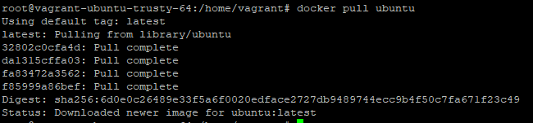
Working with containers
1. First we will pull images from docker registry.
2. We will pull images. Eg:ubuntu

Slide 26
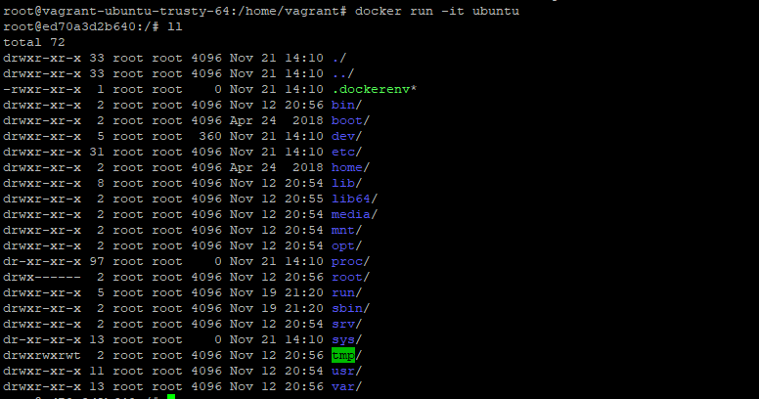
3. After pulling you can see docker image if u give docker images command.
4. We will run the image to make a container.

Slide 27
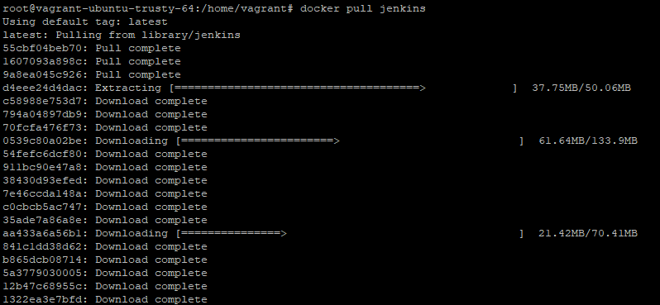
5. We can check container process by using these commands.
Eg2:JENKINS
1. docker pull Jenkins command for pulling Jenkins image.

Slide 28

2. Pull is complete. Checking by docker images command.
3. Next we will run Jenkins image to make a container.
docker run -p 8090:8080 -p 50000:50000 Jenkins
This will store the workspace in /var/jenkins_home. All Jenkins data lives in there - including plugins and configuration.
-p 8080:8080 – it exposes container’s port 8080 to the local system port 8080
-p 50000:50000 – same as above, but with the port 50000

Slide 29
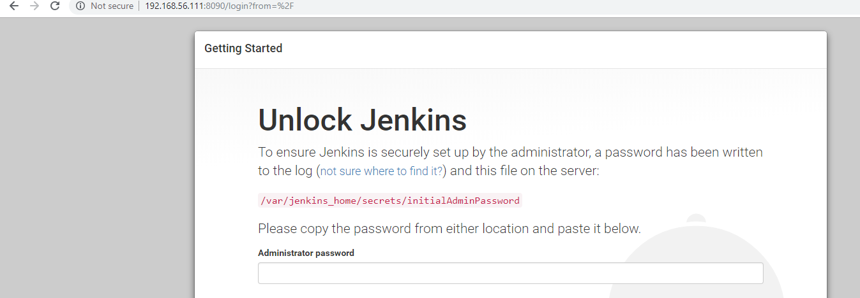
docker run -p 8080:8080 -p 50000:50000 -v /your/home:/var/jenkins_home Jenkins.
This will store the jenkins data in /your/home on the host.

Slide 30
Thank you.

